Slide 1
Computational Chemistry
Lecture 13: Surfaces

Slide 2
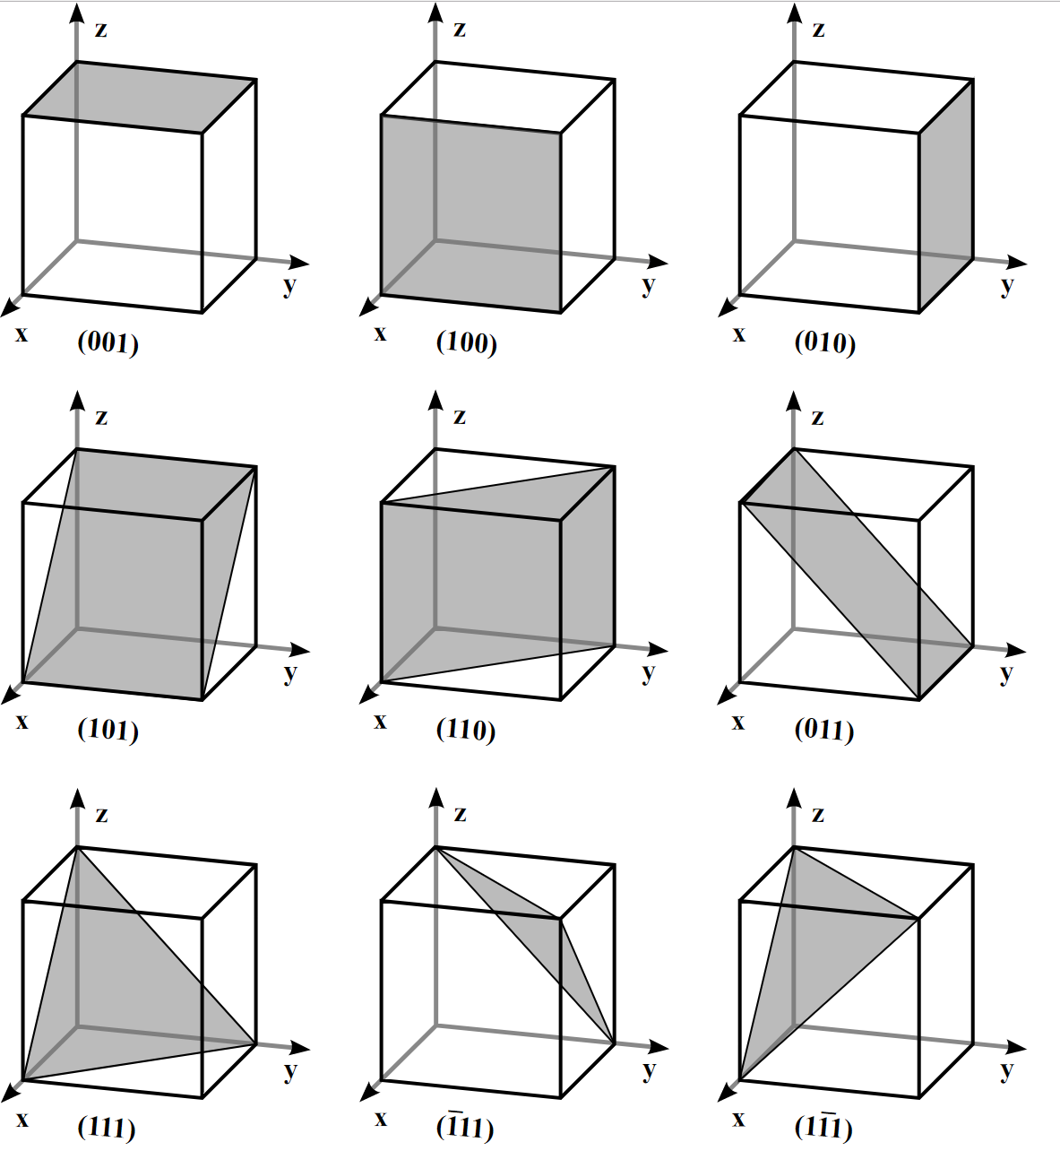
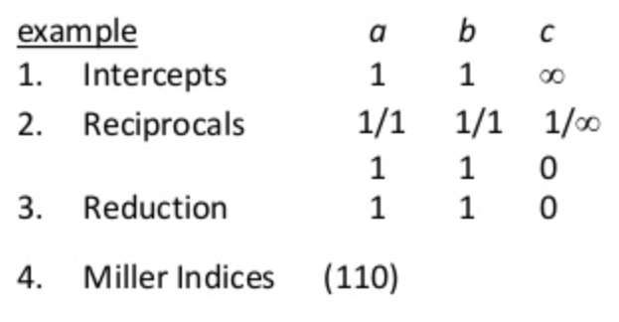
1. Geometry of Surfaces
Surface: from cleaving a crystal (Bravais lattice) along some plane
Classification of surfaces by Miller indices (hkl)
Example: Miller indices for cubes

Slide 3
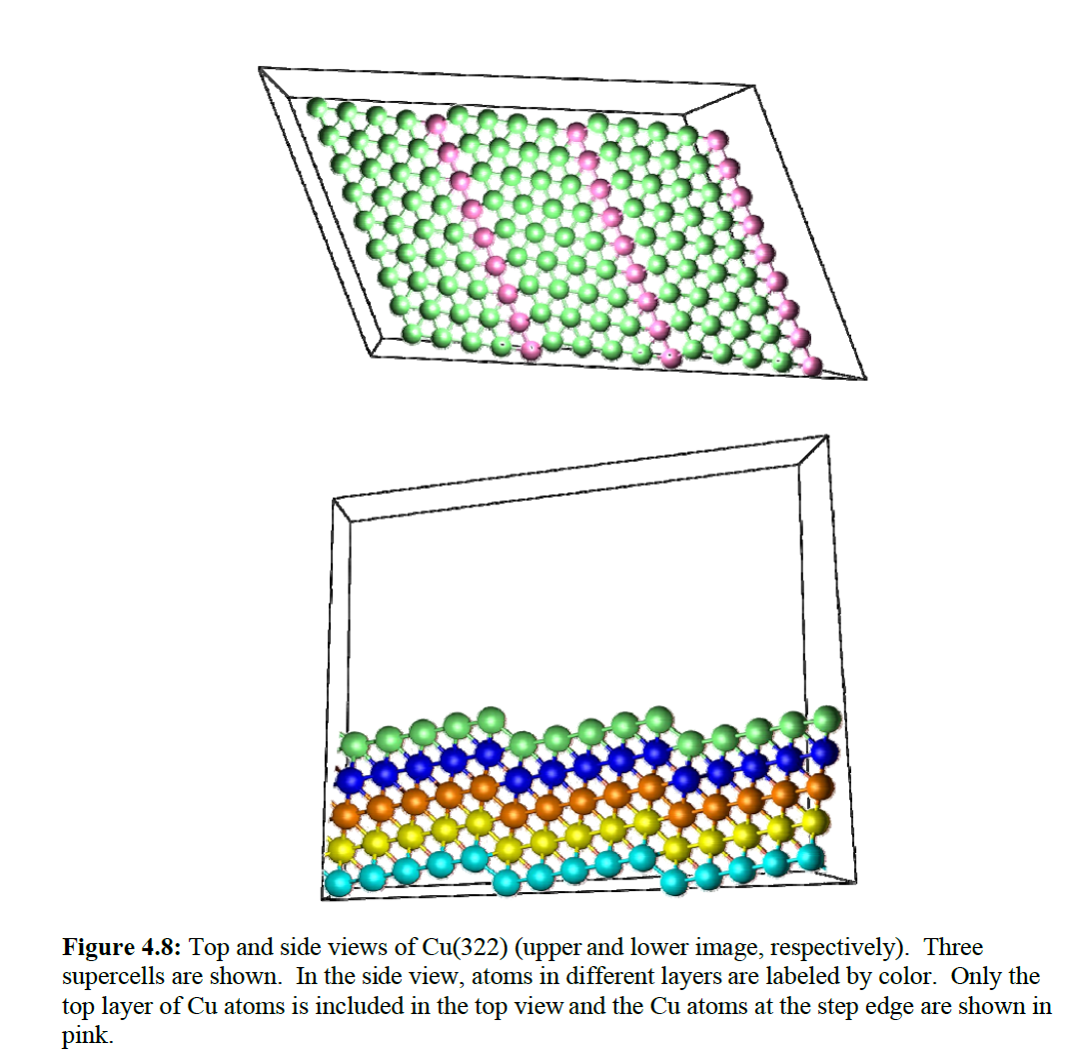
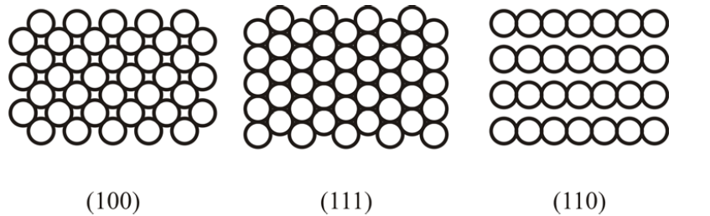
1. Geometry of Surfaces
Low-index surfaces: stable
High-index surfaces: high reactivity
Top-down views of FCC (100), (111), (110)
Top and side views of FCC (322)
Sholl/Steckel, Density Functional Theory: A Practical Introduction

Slide 4
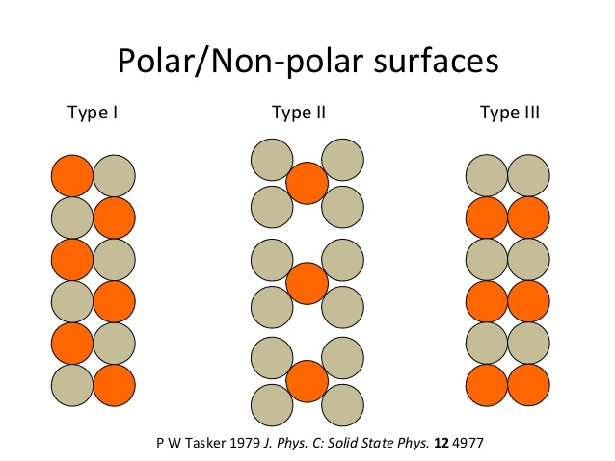
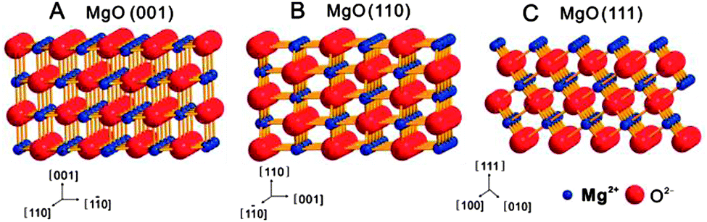
2. Ionic Crystal Surfaces
Classification of ionic surfaces by surface charges and dipole:
Tasker type I: individual layers are charge neutral, no dipole [MgO(001)]
Chem. Soc. Rev., 2014, 43, 1543--1574

Slide 5
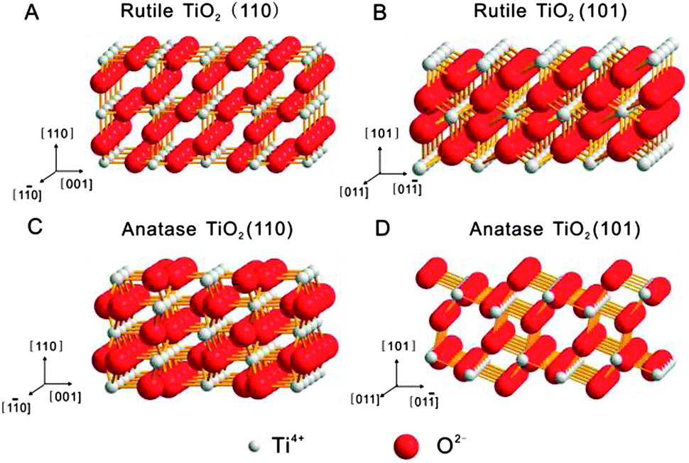
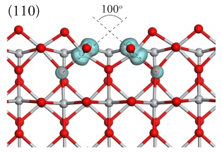
2. Ionic Crystal Surfaces
Classification of ionic surfaces by surface charges and dipole:
Tasker type I: individual layers are charge neutral, no dipole [MgO(001)]
Tasker type II: individual layers are charged, but groups of layers are charge neutral and nonpolar [TiO₂(110)]
Chem. Soc. Rev., 2014, 43, 1543--1574

Slide 6
2. Ionic Crystal Surfaces
Classification of ionic surfaces by surface charges and dipole:
Tasker type I: individual layers are charge neutral, no dipole [MgO(001)]
Tasker type II: individual layers are charged, but groups of layers are charge neutral and nonpolar [TiO₂(110)]
Tasker type III: groups of layers have net dipole [MgO(111)]
Chem. Soc. Rev., 2014, 43, 1543--1574

Slide 7
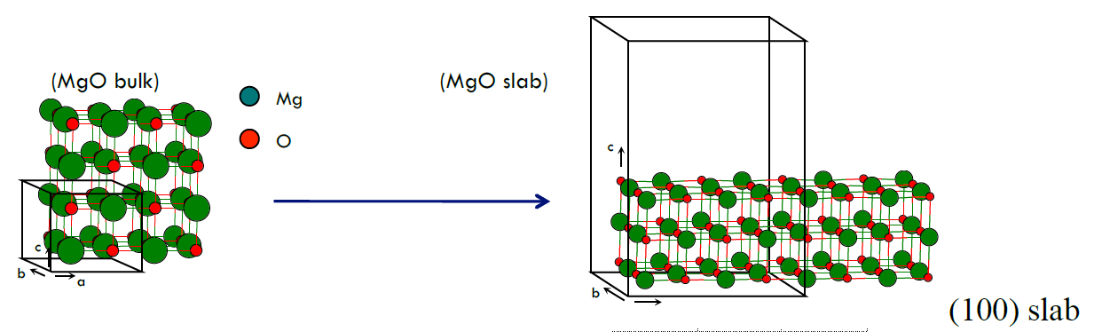
3. Surface slab models
Take advantage of periodic boundary conditions: infinite in two dimensions and with vacuum spacing between successive slabs
Sufficiently broad vacuum region to decouple the slabs
Sufficient slab thickness to mimic semi-infinite crystal
Semiconductors: saturate dangling bonds on the back surface
Inequivalent surfaces: use dipole correction
Alternative: cluster model

Slide 8
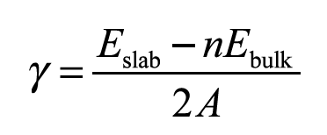
4. Surface energy
Surface energy is the energy required to cleave an infinite crystal in two – i.e. the amount of energy required to create a new surface.
E_{slab} and E_{bulk} are energies from supercells of different shapes and sizes, particular care has to be taken use equivalent lattice constants, computational parameters, energy cutoffs, and k point samples.
k point sampling: M×N×1 k-point mesh
Surface relaxation: fix one side of the slab at the bulk positions and relax the other

Slide 9
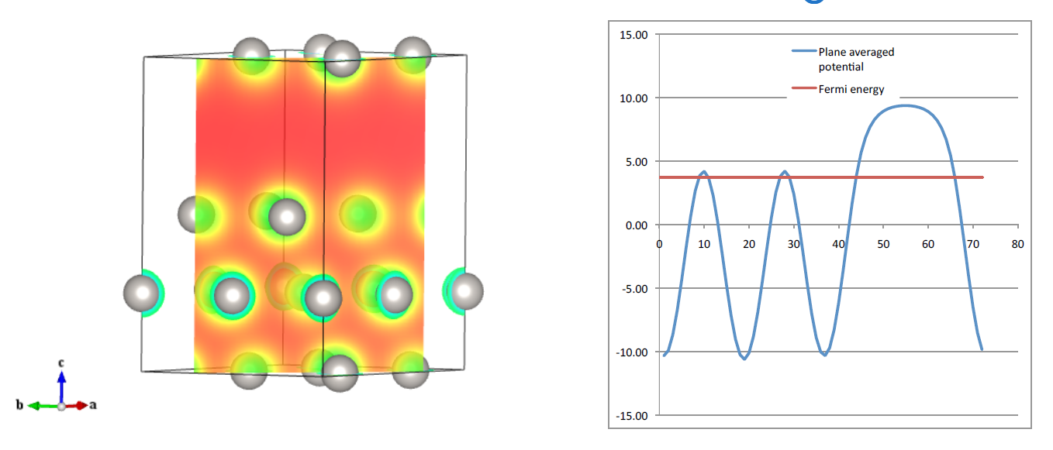
5. Surface potentials and Fermi energies
Work function: the energy required at 0 K to remove an electron from the Fermi level of the metal to the vacuum potential.
Set LVTOT=.TRUE., prints LOCPOT file which contains the local potential energy on a grid filling the supercell.
From Pt(111) calculation, LOCPOT slice and plane-averaged potential:

